Slide 1
IST 659 Final Project
E-commerce Database Management System
Members:
Akshita Reddy
Maitreyi Ahire
Melita Coutinho
Vedant Patil

Slide 2
Project Overview
The objective of this project is to develop a robust database management system to improve the efficiency and accuracy of an eCommerce website's operations
The database will store, organize, and retrieve data on customers, orders, payments, and shipments
This system will help to ensure accurate inventory management, which is crucial for eCommerce platforms that need to manage a constantly changing inventory due to restocking, sales, and product additions
The database management system will also facilitate quick and accurate order processing, which is vital for maintaining customer satisfaction
The system will also provide data security to ensure the confidentiality and privacy of the stored information.
The project aims to provide a comprehensive solution to the complex needs of an eCommerce website, streamlining the storage and retrieval of large amounts of data and supporting efficient operations

Slide 3
Goals
Develop an online database management system to store and organize customer, order, payment, and shipment records.
Improve inventory management by providing accurate, real-time data on inventory levels.
Enhance order processing speed and accuracy, resulting in higher customer satisfaction.
Provide robust data security to protect sensitive information and ensure compliance with data privacy regulations.
Increase operational efficiency by eliminating the need for physical inventory records and streamlining data retrieval.
Facilitate better communication and collaboration among all users of the eCommerce website.
Enhance the user experience by providing a more convenient and accessible way to manage orders and track shipments.
Provide an adaptable and scalable solution to support future growth and expansion of the eCommerce website.

Slide 4
Specifications
Entity Relationship Data Requirements/Business Rules
Conceptual Data Model
Logical Data Model
SQL/Up/Down Script to create/drop tables, keys constraints*
User Interface Design
Business Questions *submitted as sql file

Slide 5
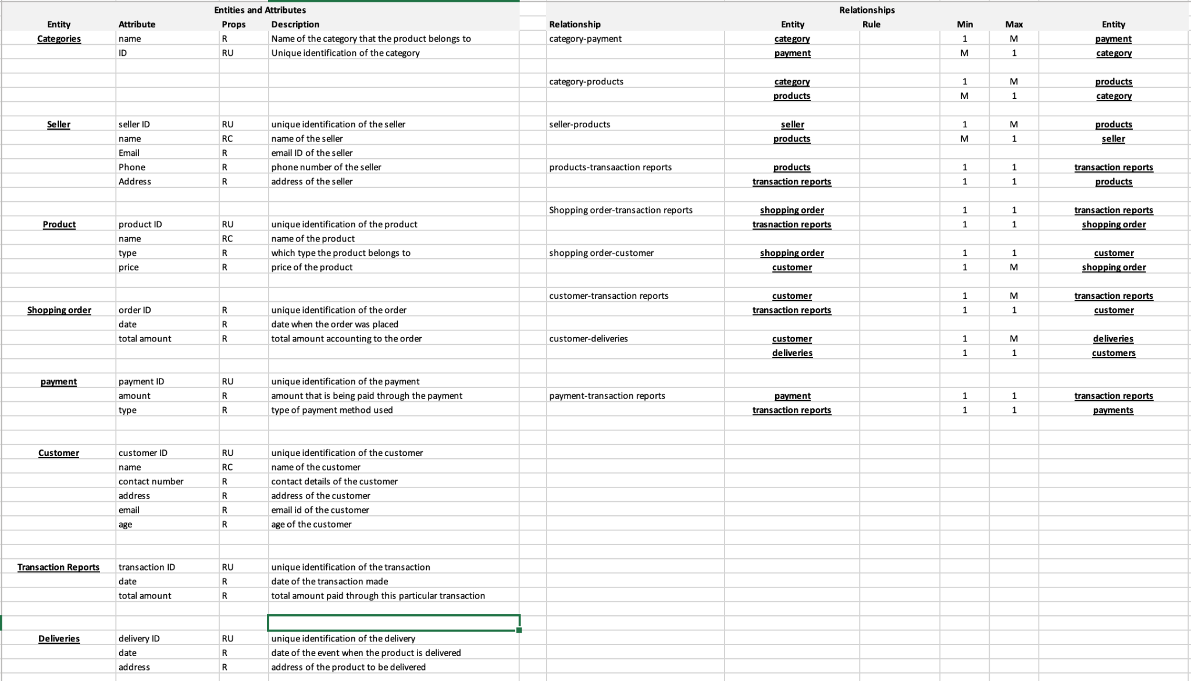
ERD Data Requirements/Business Rules

Slide 6
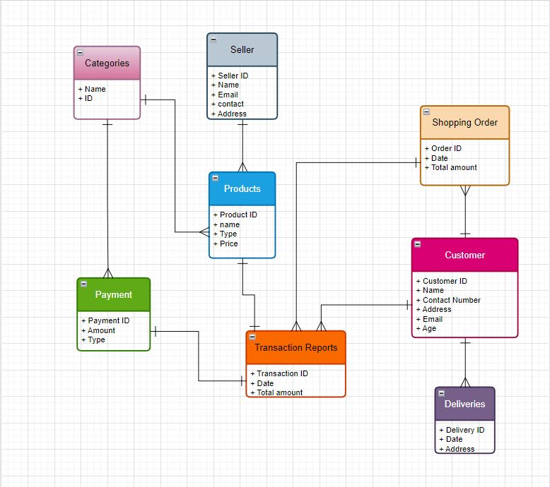
Conceptual Model

Slide 7
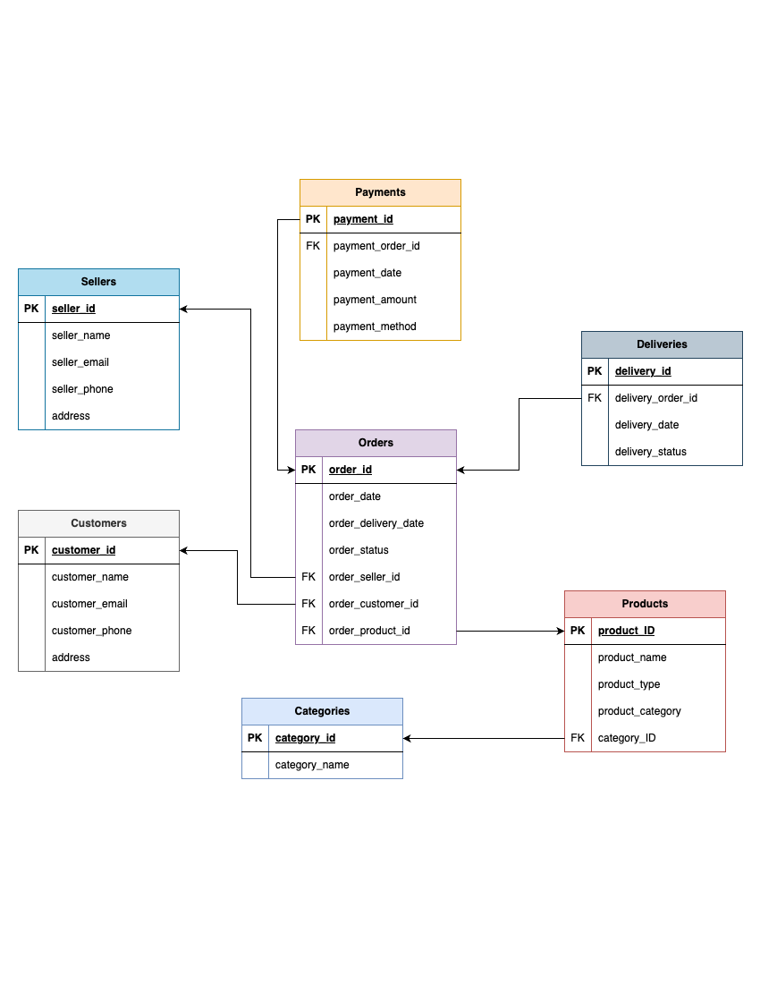
Logical Data Model

Slide 8
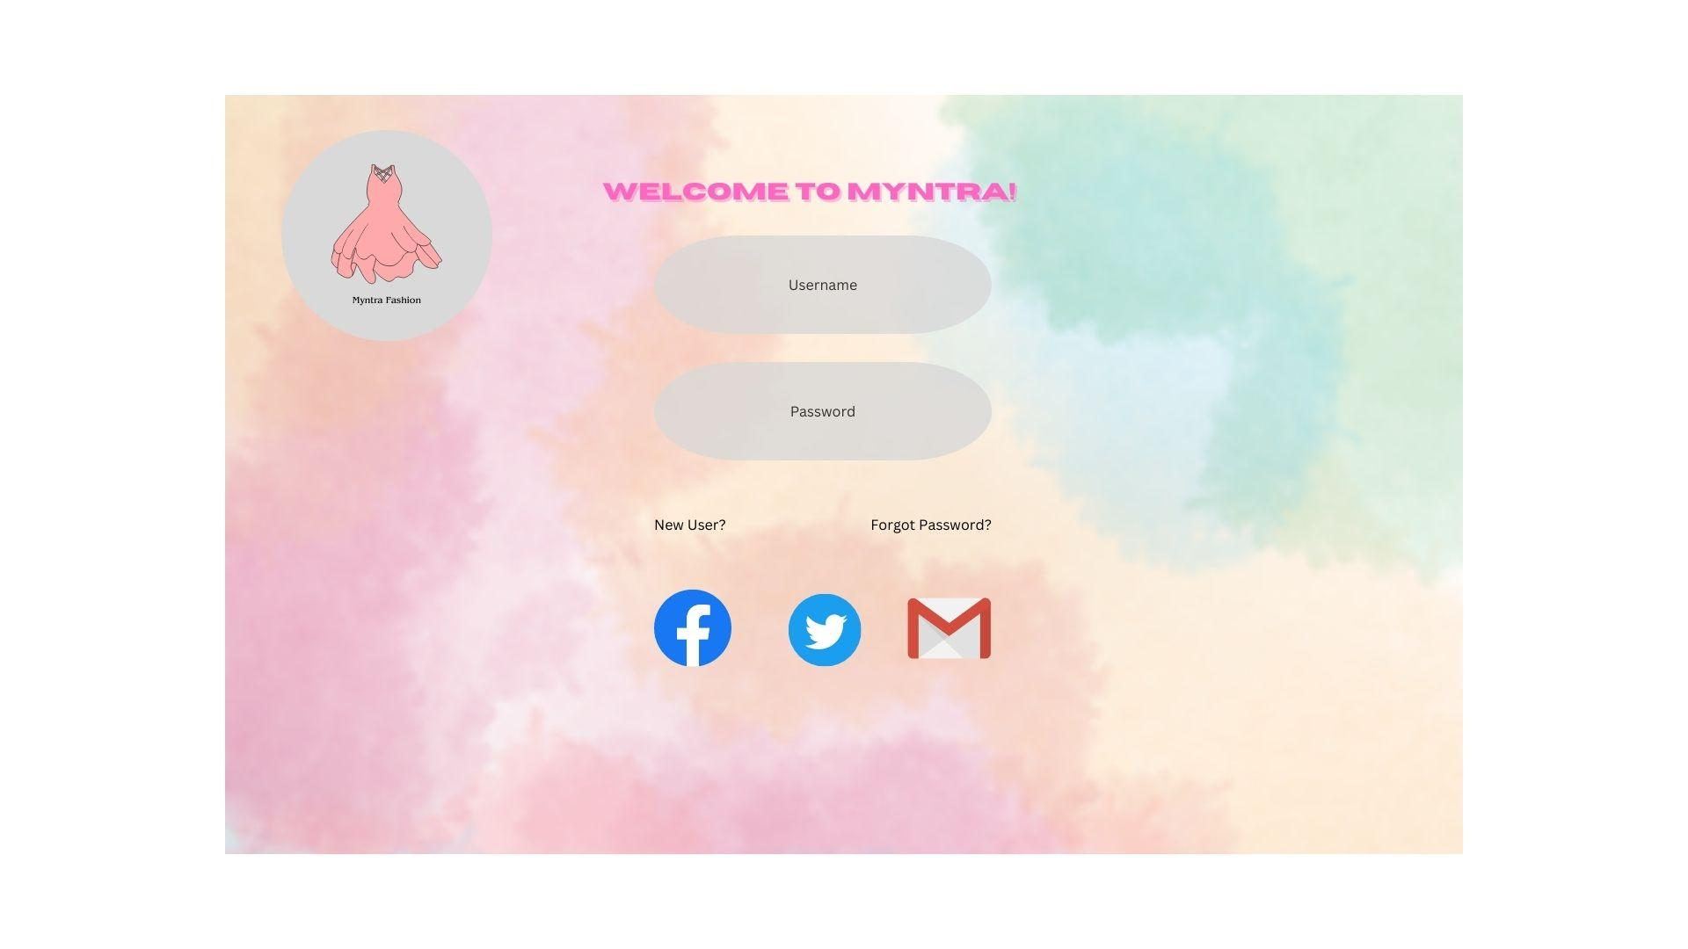
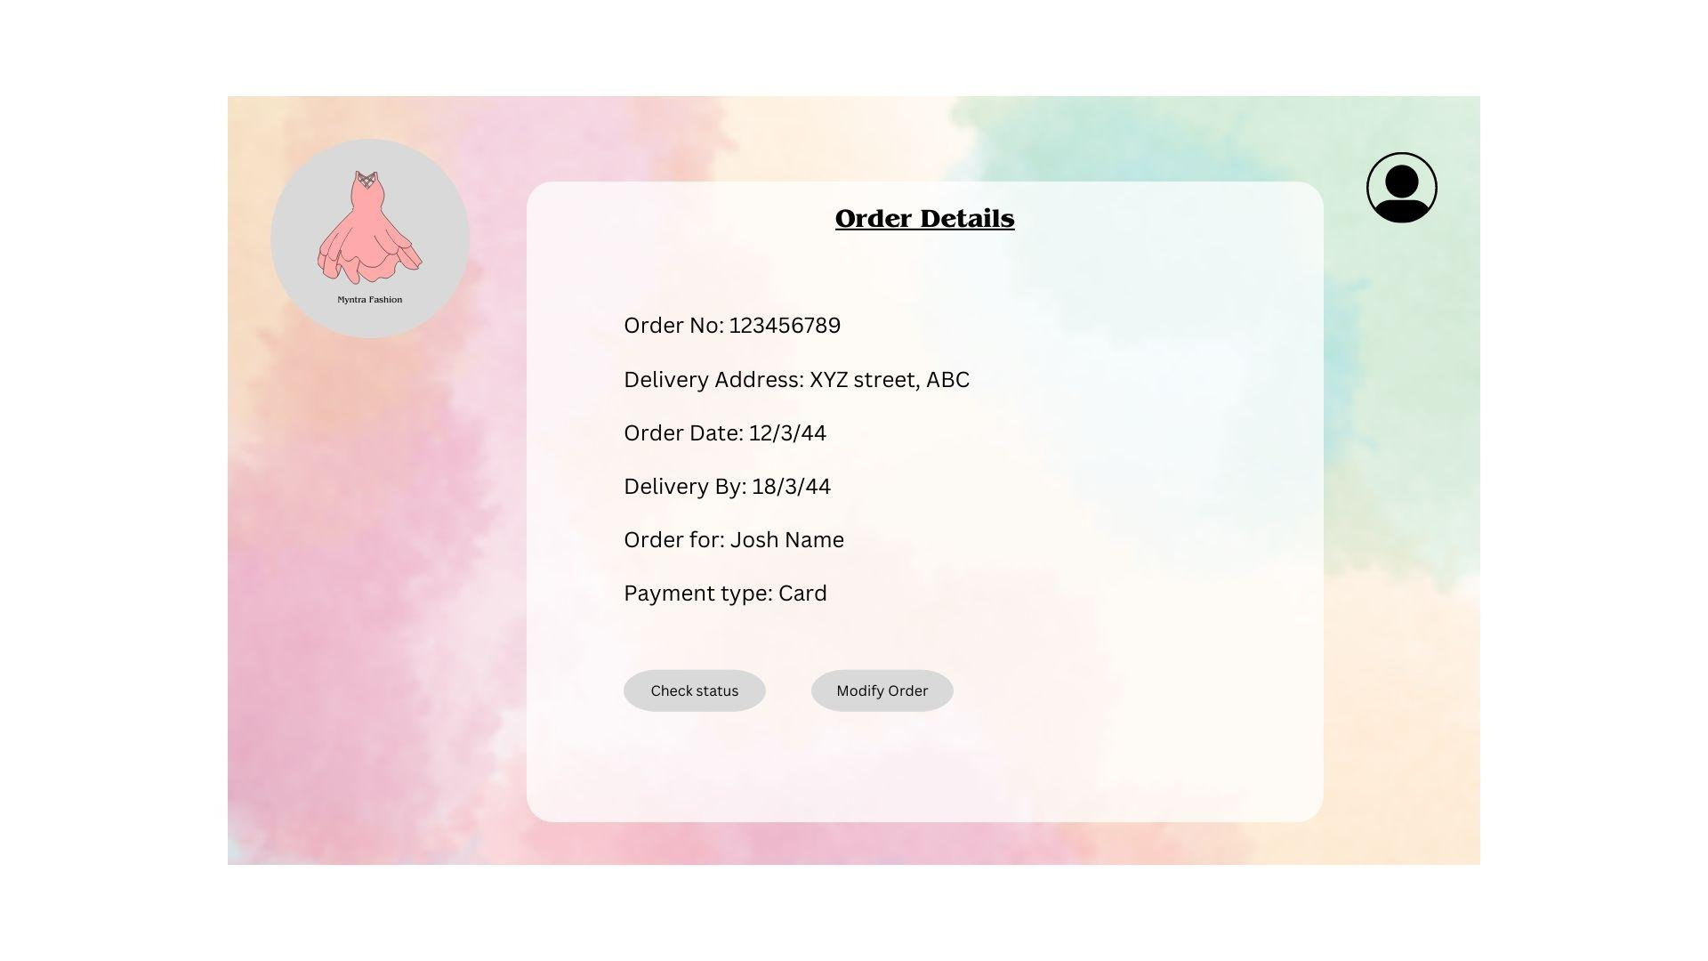
UI/UX

Slide 9
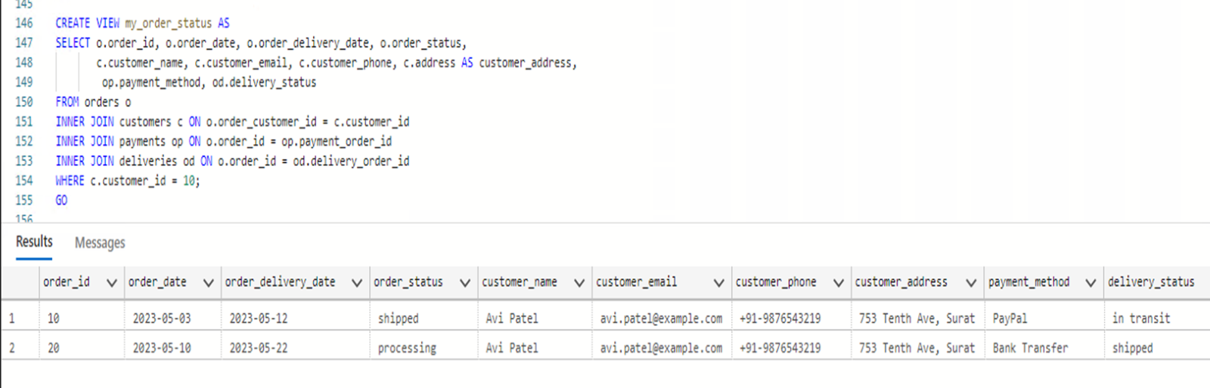
Business Questions
As a user (customer) I would like to see my payment and delivery status with order details?
Query:
CREATE VIEW my_order_status AS
SELECT o.order_id, o.order_date, o.order_delivery_date, o.order_status,
c.customer_name, c.customer_email, c.customer_phone, c.address AS customer_address, s.seller_name, s.seller_email, s.seller_phone, s.address AS seller_address, op.payment_method, od.delivery_status
FROM orders o
INNER JOIN customers c ON o.order_customer_id = c.customer_id
INNER JOIN sellers s ON o.order_seller_id = s.seller_id
INNER JOIN payments op ON o.order_id = op.payment_order_id
INNER JOIN deliveries od ON o.order_id = od.delivery_order_id
WHERE c.customer_id = 10
GO

Slide 10
Business Questions
How can we automate the process of updating the status of an order to 'delivered' when the delivery status of the order is updated to 'delivered' in the system?
Query:
CREATE TRIGGER order_delivered_trigger
ON deliveries
AFTER UPDATE
AS
BEGIN
IF UPDATE(delivery_status) AND EXISTS (SELECT * FROM inserted WHERE delivery_status = 'delivered')
BEGIN
UPDATE orders
SET order_status = 'delivered'
FROM orders
INNER JOIN inserted
ON orders.order_id = inserted.delivery_order_id END
END
GO

Slide 11
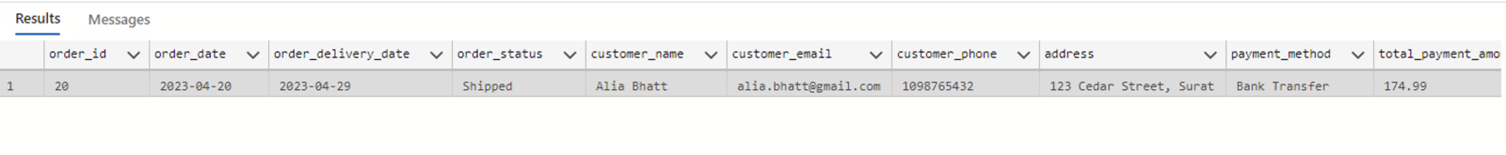
Business Questions
What is the total payment amount for each order placed by customer ID 20, including any partial payments made over time?
QUERY:
SELECT order_id, order_date, order_delivery_date, order_status, customer_name, customer_email, customer_phone, customer_address, payment_method, delivery_status,
SUM(payment_amount) OVER (PARTITION BY order_id) AS total_payment_amount
FROM
orders
INNER JOIN customers ON orders.order_customer_id = customers.customer_id
INNER JOIN payments ON orders.order_id = payments.payment_order_id
INNER JOIN deliveries ON orders.order_id = deliveries.delivery_order_id
WHERE
customer_id = 20;

Slide 12
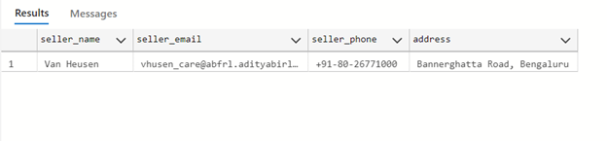
Business Questions
From a business perspective, when a delivered order comes back with any defects, we will have to contact the sellers to return it to their warehouse and get the good quality product to sent it to the customer again. For this it is important to have the sellers details such as their name, email contact number and address.
QUERY:
SELECT seller_name, seller_email, seller_phone, address from sellers
where seller_name = 'Van Heusen'

Slide 13
Business Questions
How will a new product be added in the system?
QUERY:
drop procedure if exists p_upsert_products
GO
create procedure p_upsert_products (
@product_name VARCHAR(100),
@product_type VARCHAR(500),
@product_category DECIMAL(10,2)
) as begin
if exists(select * from products where product_name = @product_name) begin
update products set product_type = @product_type
where product_name = @product_name
end
else begin
insert into products (product_name, product_type, product_category)
values (@product_name, @product_type, @product_category)
end
end
GO

Slide 14
Thank you!
Any questions?

